Slide 1
Validations Techniques

Slide 2
Validation in Machine Learning
Validating the machine learning model outputs are important to ensure its accuracy.
Basically, when machine learning model is trained, (visual perception model), there are huge amount of training data sets are used and the main motive of checking and validating the model validation provides an opportunity to machine learning engineers to improve the data quality and quantity.
Data validation means checking the accuracy and quality of source data before training a new model version.
It ensures that anomalies that are infrequent or manifested in incremental data are not silently ignored.
It focuses on checking that the statistics of the new data are as expected (e.g. feature distribution, number of categories, etc).

Slide 3
WHY ML MODEL VALIDATION IS IMPORTANT?
Actually, without checking and validating the model it is not right to rely on its prediction.
In sensitive areas like healthcare and self-driving cars, any kind of mistake in object detection can leads to major fatalities due to wrong decision taken by the machine in the real-life predictions.
Validating the ML model at training and development stage helps to make the model make the right predictions.

Slide 4
HOW MACHINE LEARNING MODEL IS VALIDATED?
There are certain techniques used in AI world.
Using the right validation model is the important to make there is no business in validating the machine learning model.

Slide 5
What are the challenges with the data validation?
There are various challenges that a data scientist faces while developing a data validation component, such as
Creating data validation rules for a dataset with few columns does sound simple. However, when the number of columns in datasets increases, it becomes a humongous task.
Tracking and comparing metrics from the historical datasets to find anomalies in historical trends for each column needs a good amount of recurring time from a data scientist.
Today applications are expected to run 24-by-7 and in such scenarios, data validation needs to be automated. The data validation component should be smart enough to refresh validation rules.

Slide 6
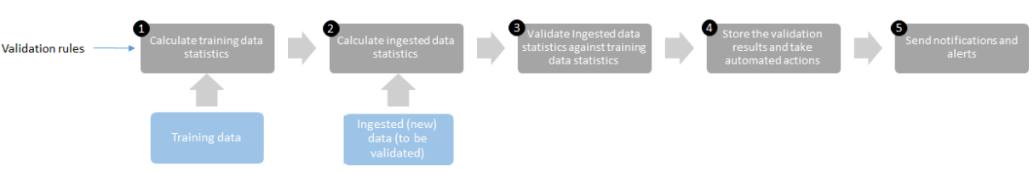
How does the data validation component work?
Calculate the statistics from the training data against a set of rules
Calculate the statistics of the ingested data that has to be validated
Compare the statistics of the validation data with the statistics from the training data
Store the validation results and takes automated actions like removing the row, capping, or flooring the values
Sending the notification and alerts for approval​​​​​​​

Slide 7

Various Validation Techniques
Train/test split
k-Fold Cross-Validation
Leave-one-out Cross-Validation
Leave-one-group-out Cross-Validation
Nested Cross-Validation
Time-series Cross-Validation

Slide 8
Splitting your data
The basis of all validation techniques is splitting your data when training your model.
The reason for doing so is to understand what would happen if your model is faced with data it has not seen before.
Train/test split
The most basic method is the train/test split.
The principle is simple, you simply split your data randomly into roughly 70% used for training the model and 30% for testing the model.

Slide 9
The benefit of this approach is that we can see how the model reacts to previously unseen data.
import numpy as np
from sklearn.model_selection import train_test_split
X, y = np.arange(10).reshape((5, 2)), range(5)
(X_train, X_test, y_train, y_test) = train_test_split(X, y, test_size=0.3, random_state=42)

Slide 10
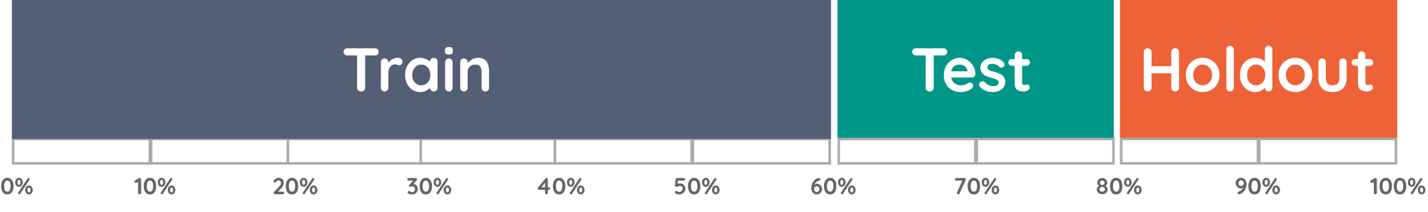
Holdout set
When optimizing the hyperparameters of your model, you might overfit your model if you were to optimize using the train/test split.
Why? Because the model searches for the hyperparameters that fit the specific train/test you made.
To solve this issue, you can create an additional holdout set.
This is often 10% of the data which you have not used in any of your processing/validation steps.

Slide 11
Holdout Method
Pros
This Method is Fully independent of data.
This Method only needs to be run once so has lower computational costs.
Cons
The Performance is subject to higher variance given the smaller size of the data.

Slide 12
Cross Validation
Cross Validation is a technique to assess the performance of a statistical prediction model on an independent data set.
The goal is to make sure the model and the data work well together.
Cross validation is conducted during the training phase where the user will assess whether the model is prone to underfitting or overfitting to the data.
The data to be used for cross validation have to be from the same distribution for the target variable or else we can mislead ourselves as to how the model will perform in real life.

Slide 13
K-fold cross-validation
K-fold cross-validation is one of the most used cross-validation methods.
In this method, k represents the number of experiments(or fold) in order to test and train data.
For example, suppose that we want to make 5 experiments(or performance) with our data composed of 1000 records.
So during the first experiment, we test or validate the first 200 records and then we train the remaining 800 records.
When the first experiment is finished and certain accuracy is obtained.
Then we make a second experiment where we test the 200 records that follow the previous records that have been tested and we train the remain 800 records.

Slide 14
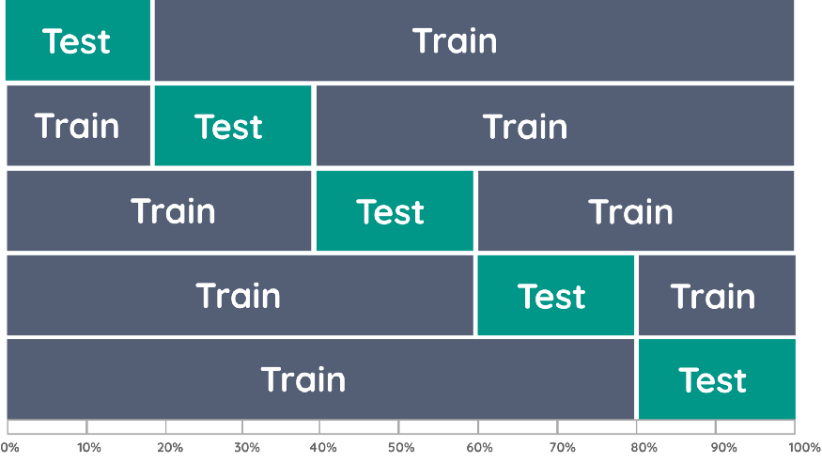

Slide 15
from sklearn.model_selection import cross_val_score
from sklearn.linear_model import LogisticRegression
logreg = LogisticRegression()
scores = cross_val_score(logreg, X,y,cv=5)

Slide 16
Pros
This will help to overcome the problem of computational power.
Models may not be affected much if an outlier is present in data.
It helps us overcome the problem of variability.
Cons
Imbalanced data sets will impact our model.

Slide 17
Leave one out Cross validation(LOOCV)
The Leave-One-Out Cross-Validation, or LOOCV, procedure is used to estimate the performance of machine learning algorithms when they are used to make predictions on data not used to train the model.
It is a computationally expensive procedure to perform, although it results in a reliable and unbiased estimate of model performance.

Slide 18
LOOCV(Leave One Out Cross-Validation) is a type of cross-validation approach in which each observation is considered as the validation set and the rest (N-1) observations are considered as the training set.
In LOOCV, fitting of the model is done and predicting using one observation validation set.
Furthermore, repeating this for N times for each observation as the validation set. Model is fitted and the model is used to predict a value for observation.
This is a special case of K-fold cross-validation in which the number of folds is the same as the number of observations(K = N).
This method helps to reduce Bias and Randomness. The method aims at reducing the Mean-Squared error rate and prevent over fitting.
Don’t Use LOOCV: Large datasets or costly models to fit.

Slide 19
Bootstrap Sampling Method
The Bootstrap Sampling Method is a very simple concept and is a building block for some of the more advanced machine learning algorithms like AdaBoost and XGBoost.
Technically speaking, the bootstrap sampling method is a resampling method that uses random sampling with replacement.

Slide 20
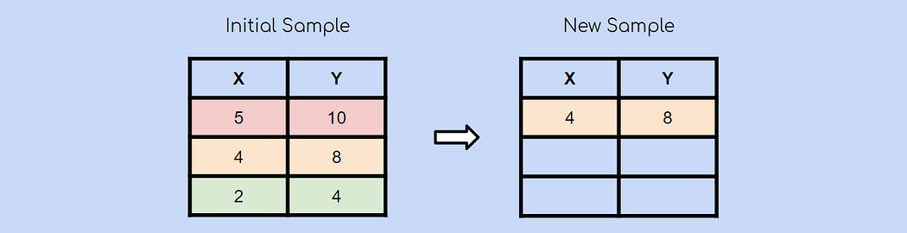
Suppose you have an initial sample with 3 observations. Using the bootstrap sampling method, you’ll create a new sample with 3 observations as well. Each observation has an equal chance of being chosen (1/3). In this case, the second observation was chosen randomly and will be the first observation in our new sample.

Slide 21
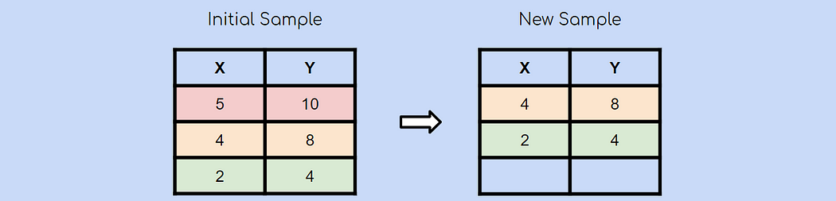
After choosing another observation at random, you chose the green observation.

Slide 22
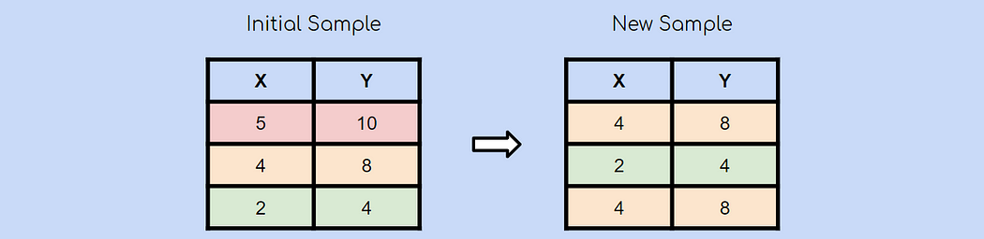
Lastly, the yellow observation is chosen again at random. Remember that bootstrap sampling using random sampling with replacement. This means that it is very much possible for an already chosen observation to be chosen again. And this is the essence of bootstrap sampling!

